Slide 1
My Notes application
Developed By Hend Moustafa

Slide 2
Introduction
Today, I’m interested to introduce you to my latest project – a note-taking application that I've been working on. But before we dive into the details, let me introduce myself.
My name is Hend Moustafa and I'm passionate about technology and its potential to make our lives easier and more organized.
With a background in being a veterinarian , and I have never studied software, I've always been fascinated by the intersection of creativity and functionality in software development.

Slide 3
Project Overview
Welcome to My Notes app project overview.
Our mission is simple: to develop a user-friendly note-taking app that simplifies the process of capturing, organizing, and managing notes.
Here's what you can expect from our project:
Efficiency: Our app focuses on streamlining the note-taking process, saving users time and effort.
User-Friendly Interface: We prioritize a clean and intuitive interface, ensuring users can easily navigate the app and focus on their notes.

Slide 4
Key Tasks and Features
User Interface Design: Utilizing HTML and CSS, we will craft a visually appealing and user-friendly interface that enhances the note-taking experience.
Note Management Functionality: JavaScript will drive the core functionality of our application, enabling users to create, edit, and delete notes effortlessly.
Essential Features: Our app will include essential features such as note creation, editing, deletion, and search functionality.
Responsive Design: With a responsive design, our app will adapt seamlessly to various devices and screen sizes, providing a consistent experience for all users.
Data Storage: We'll implement secure data storage options, ensuring users can access their notes reliably across devices.

Slide 5
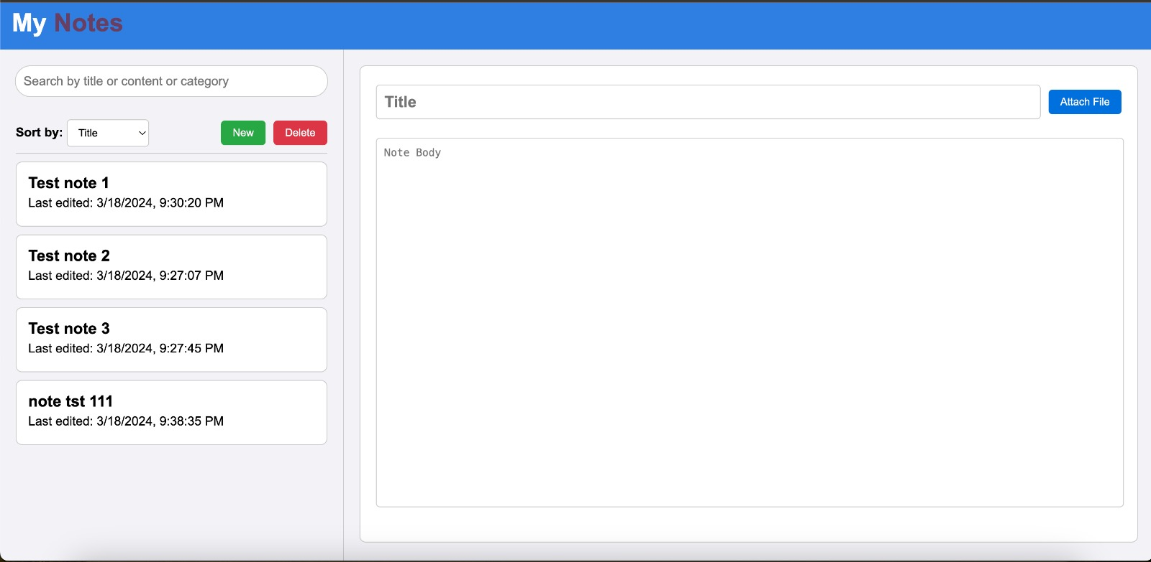

Slide 6
About Me
LinkedIn URL: https://www.linkedin.com/in/hend-mostafa-2152b5299/
Email: dr_hend_vet@yahoo.com
Link for the live Demo: https://youtu.be/8ZeKkap443I

Slide 7
Thanks

